Slide 1

Bitcoin, Cryptocurrencies and the Blockchain

Slide 2

The Oklahoma Department of Securities Invest Ed® program has provided this information as a service to investors. Invest Ed does not recommend any particular investment strategy or plan, any type of product, or any securities professional over another. No part of Invest Ed shall be taken as investment and/or legal advice.

Slide 3
Cryptocurrencies
Digital currencies, or assets used in electronic transactions.
Notes:
Cryptocurrencies are digital currencies, or assets used in electronic transactions.
Cryptocurrencies are private assets, not controlled or created by central banks, that trade on electronic exchanges. They represent a new form of digital money that trades on peer-to-peer computer networks.

Slide 4
Price is not fixed
It fluctuates with investor demand
Notes:
The price of a cryptocurrency is not fixed; it fluctuates with investor demand. The volatility of many cryptocurrencies may limit acceptance and trust by users.

Slide 5
ICO
Or initial coin offering
Notes:
When a group or company wants to issue, or create, a digital currency or token, it launches an ICO, or initial coin offering.
Many ICOs have been accused of being modern-day “pump and dump” schemes, where early investors buy the coins cheap, and then sell once the price has run up due to marketing hype and promotion. Think of it as crowdfunding for creating a new currency.

Slide 6
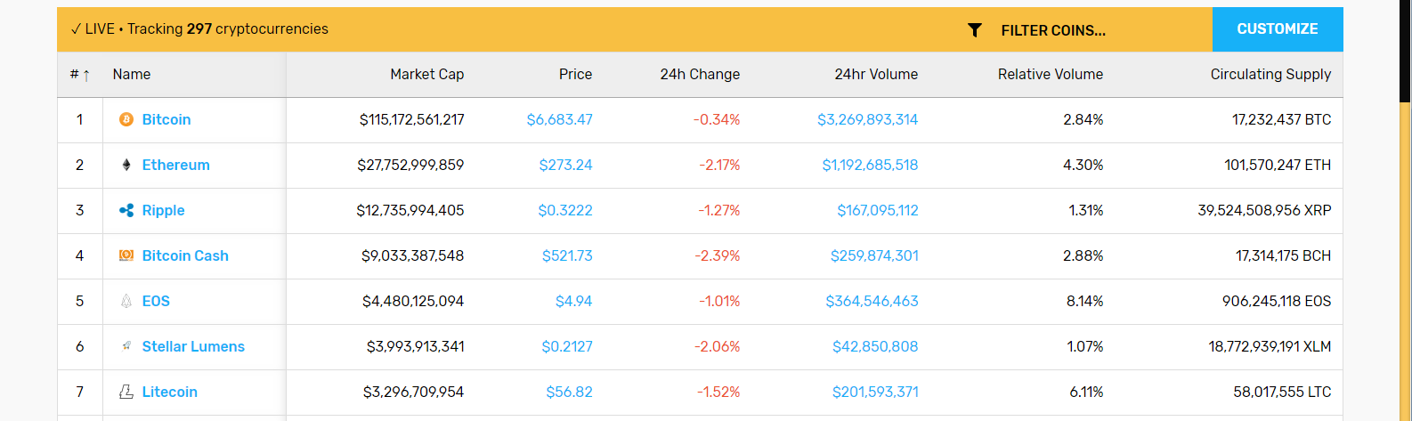
Prices are tracked online at sites like Coin Central
Notes:
Prices of the most popular cryptocurrencies can be easily tracked online at sites like, Coin Central (see example).

Slide 7
The risks of using cryptocurrencies include:
There is no limit to the number of different cryptocurrencies that can be created
There is limited acceptance by the electronic commerce market place
Your digital wallet, where you keep your cryptocurrencies, can be hacked
Notes:
The risks of using cryptocurrencies include:
1,there is no limit to the number of different cryptocurrencies that can be created
2. there is limited acceptance by the electronic commerce marketplace
3, Your digital wallet, where you keep your cryptocurrencies, can be hacked.

Slide 8
Bitcoin
is a digital, or virtual, currency used in electronic payment systems
Bitcoins can be stored in a virtual wallet holds a private key or code to the access the currency
Notes:
What is Bitcoin?
Bitcoin is a digital, or virtual, currency used in electronic payment systems.
As the most popular of the cryptocurrencies, Bitcoin can be traded, like a speculative asset, and can be used to buy and sell goods and services online.
Developed by Satoshi Nakomoto, a mysterious figure who may not be a real person, Bitcoin has been primarily accepted by fans of technology and cynics of the global central banking system.
In order to own Bitcoin, you need to be access a bitcoin client, or software interface, in order to access a peer-to-peer network to make transactions. Investors can store their Bitcoins in a virtual wallet that holds a private key or code to the access the currency.
The value of Bitcoin is determined by market participants and can fluctuate significantly.

Slide 9
blockchain
An online electronic ledger
Digital security and encoded transactions are vital in the Bitcoin market. Owners of Bitcoin need to keep “private keys” or password safekeeping devices.
Notes:
The records of bitcoin trades are stored on the “blockchain”, an online electronic ledger.
Digital security and encoded transactions are vital in the Bitcoin market. Owners of Bitcoin need to keep “private keys” or password safekeeping devices.

Slide 10
Advocates of Bitcoin promote 2 main benefits
The supply of Bitcoin is limited; creating, or “mining” Bitcoin is a complex process of solving encoded puzzles to help verify transactions, requiring significant computing power and electricity
Bitcoin has a decentralized ecosystem, meaning it is not controlled by any government entity or central bank.
Notes:
Advocates of Bitcoin promote the two main benefits:
First, the supply of Bitcoin is limited; creating, or “mining” Bitcoin is a complex process of solving encoded puzzles to help verify transactions, requiring significant computing power and electricity.
Second, Bitcoin has a decentralized ecosystem, meaning it is not controlled by any government entity or central bank.

Slide 11
Skeptics of Bitcoin claim:
Primary users and traders of Bitcoin use the currency for nefarious purposes. In fact, the first uses of Bitcoin were for transactions on the dark web, such as drugs, stolen credit cards, and even assassinations.
The lack of regulation in the Bitcoin market has opened the door to online thefts within various Bitcoin exchanges.
Notes:
Skeptics of Bitcoin claim that the primary users and traders of Bitcoin use the currency for nefarious purposes. In fact, the first uses of Bitcoin were for transactions on the dark web, such as drugs, stolen credit cards, and even assassinations.
In addition, the lack of regulation in the Bitcoin market has opened the door to online thefts of various Bitcoin exchanges.
However, several financial exchanges and investment firms have begun to allow customers to trade Bitcoin futures contracts and other cryptocurrencies as speculative assets, indicating that these financial institutions see a future for Bitcoin.

Slide 12
A Little More About Blockchain
Remember the blockchain is a shared digital ledger used for recording electronic transactions
The ledger is distributed and validated by its members
Invented to save time, money, and paperwork
Advocates say it removes costly intermediaries in financial institutions
It is a peer-to-peer network where participants verify each other’s transactions
Notes:
Blockchain
The blockchain is a shared digital ledger used for recording electronic transactions. Examples of these transactions may be buying and selling digital currencies or completing financial contracts. The ledger is distributed and validated by its members.
It was invented to save time, money, and paperwork. Advocates of the blockchain promote the opportunity to remove costly intermediaries in financial transactions.
Best known for recording Bitcoin transactions, the blockchain is a peer-to-peer network where participants verify each other’s transactions.
There is more than one kind of blockchain, but certain traits are common to all of them, so I will refer to similar networks as part of the “blockchain”.

Slide 13
Smart contracts
are digital agreements that govern a transaction, to simplify the financial infrastructure in the US and elsewhere. The purpose of these contracts is to eliminate intermediaries that can add significant cost, like a broker who collects fees and commissions.
Notes:
The goal of blockchain technology is to use “smart” contracts, which are digital agreements that govern a transaction, to simplify the financial infrastructure in the United States and elsewhere. The purpose of these contracts is to eliminate intermediaries that can add significant cost, like a broker who collects fees and commissions.
Many banks and financial institutions have invested significant resources into blockchain technology.
The “chain” in the blockchain is a collection of validated transactions (called blocks). Each block contains the timestamped collection of code that verifies the transactions.
The members of the blockchain network work to solve a complex mathematical puzzle. The first to solve the puzzle gets a reward (like Bitcoins). The transaction is locked, but can be solved through cryptography. Each block verifies the previous block. There is no incentive to verify false transactions.
Aspects of the blockchain are much more complex than what is presented here, and I encourage you to investigate the more technical points on your own if you are interested.
There is significant information on the internet about the blockchain, Bitcoin, and the cryptocurrency ecosystem. Please be sure to trust only reliable and independent research.

Slide 14
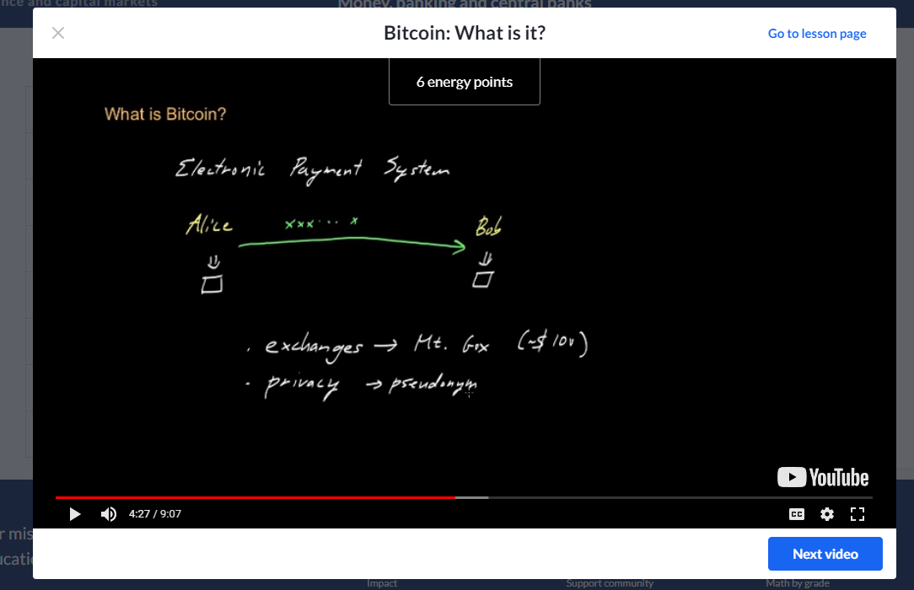
Khan Academy’s Money and Banking Curriculum
Notes:
In Khan Academy’s Money and Banking curriculum, there is a section called “Bitcoin”. It explains the technical aspects quite well. The screen shot in this slide is from the site.

Slide 15
Terms
Cryptocurrencies
Bitcoin
Blockchain
ICO
Virtual Wallet
Smart Contracts

